Slide 1



Parental HIV Disclosure: Scoping Literature Review with a Lens on Information Behavior
Katie Veeninga, MLIS, PhD Student
School of Information, Dominican University
Notes:
Good morning and thank you for being here. My name is Katie Veeninga and I am a PhD student at Dominican University in River Forest, Illinois. My doctoral research focus is the impact of technology and policy on health information behavior. I have worked as a health information practitioner for almost 20 years, within healthcare organizations and as a consultant. I’ve worked in various roles with the goal of accessibility to health data. The one thing that has been consistently true in my professional experience, is that technology and policy is not a simple solution for impacting health outcomes through behavior. Technology nor policy alone does not transform health data into information, nor health information into actionable knowledge. And it is from that lens and experience that my academic focus is on health information behavior.

Slide 2
Defining Disclosure
“something (such as information) that is made known or revealed
(Britannica Dictionary, n.d., Definition 2)
“the act of making something known or the fact that is made known”
(Cambridge English Dictionary, n.d.)
“the act of parents living with HIV (PLH) telling their children about their HIV diagnosis”
(Da et al., 2024)
Notes:
Disclosure is defined by the Cambridge English Dictionary as “the act of making something known or the fact that is made known” and
the Britannica Dictionary defines disclosure as “something (such as information) that is made known or revealed
For the purposes of this study, parental HIV disclosure is defined as “the act of parents living with HIV telling their children about their HIV diagnosis”

Slide 3
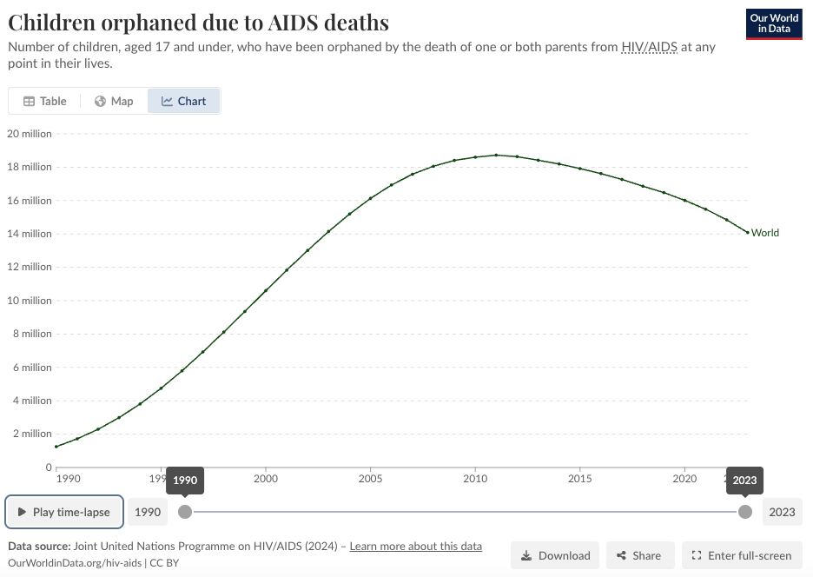
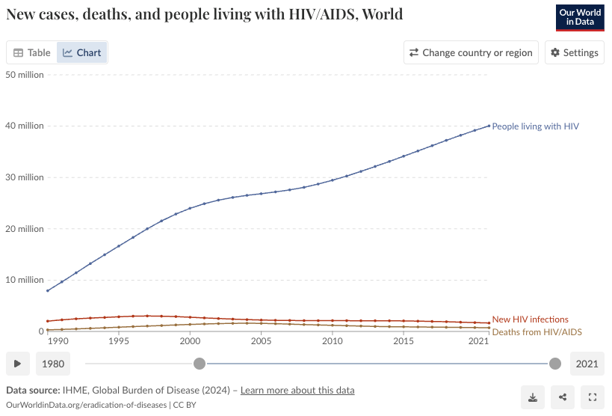
Why Parental Disclosure?
14.1M
40.04M
Figure 1. Children orphaned due to AIDS deaths (Roser & Ritchie, 2023)
Figure 2. New cases, deaths, and people living with HIV/AIDS (Roser & Ritchie, 2023)
Notes:
As of 2023, roughly 14.1 million children under the age of 17 have lost one or both parents to HIV/AIDS. And I, by the way, am one of them.
Millions more have been affected by the epidemic, through a heightened risk of poverty, homelessness, school dropout, discrimination and loss of opportunities,
There have been great strides in treatment. As of 2021, just over 40 million people are living with HIV. Progress in treatment is prolonging the lives of parents living with HIV and is increasing the number of people living with HIV becoming parents. These factors have increased the number of children impacted by their parents HIV status. One way to support these children is through encouraging parental HIV disclosure.
However, prevalence of parental HIV disclosure to children remains low or unknown beyond a wide range. Research has been conducted on the prevalence and influencing factors of this disclosure. However, this research has also identified gaps in research that have not yet been fulfilled.

Slide 4
Research Questions
Scoping Literature Review
What research has been done about parental HIV disclosure?
How has information behavior theory been applied to research about parental HIV/AIDS disclosure?
Notes:
To that end, this research aimed to align previously identified and new research findings to opportunities that may benefit from the application of information behavior theory. The questions this research sought to answer are:
1) What research has been done about parental HIV disclosure?
2) How has information theory been applied to research about parental HIV/AIDS disclosure?

Slide 5







Data Set
2002 - 2023
1
1
11
3
Research Studies
1
4
Qualitative Studies
2
2
4
Randomized Controlled Trials
Mixed-methods Studies
1
1
Systematic Literature Review
2
Notes:
This literature review surveyed a representative sampling of peer-reviewed research articles. The studies surveyed took place between 2002 through 2023.

Slide 6

Benefits
Access to greater support as one benefit of disclosure (5)
Reduced stress, anxiety, and/or depression as a benefit of disclosure (4)
Improvement to the parent’s treatment adherence (3)
Better communication within the family (3)
Improvement in the quality of family relationships (3)
Notes:
Numerous benefits to parental disclosure have been identified and there is much consistency to the benefits found in the research. In the literature surveyed for this literature review, six research articles discussed benefits of parental HIV status disclosure to children.
5 identified access to greater support
4 research studies identified reduced stress, anxiety, and/or depression
3 of the 6 research studies identified improvement to the parent’s treatment adherence
3 research studies identified better communication within the family
3 research studies identified an improvement in the quality of family relationships
Despite variations in research methods and populations studied, the benefits of parental disclosure of HIV/AIDS status to children are generally consistent.

Slide 7
Barriers
Fear of negative reactions (4)
Child's age and related ability to understand (3)
Need for more support & knowledge (1)
Causing children worry (3)
Status deserves protection (2)
Anticipation of stigma
Discrimination
Disrespect
HIV
Sex generally
Maintaining confidentially
“…parents were also concerned that a child might be too young to understand confidentiality or how to “keep secrets”
(Cyrus et al., 2023, p. 7).
Notes:
Of the research surveyed for this review, there was also consistency in barriers noted or identified to parental HIV/AIDS disclosure to children.
The most common barrier to parental disclosure was fear of negative reactions from either the children, the community, or both
Negative reactions identified included anticipation of stigma, discrimination and/or disrespect
Another barrier was fear about the child’s age and related ability to understand information about HIV/AIDS and its significance
Research participants described concerns about their children understanding HIV and/or sex generally and a fear that their children would not be able to maintain confidentiality due to not understanding the significance of the information
A need for more support and knowledge about how to disclose was identified
As well as fears about the reaction of children to the disclosure such as causing the children worry and a feeling that HIV status deserved protection and was not their children’s business
So, while there were variations in research methods and populations studied, the barriers to parental HIV/AIDS disclosure to children depicted many similarities

Slide 8

Interventions
Need for interventions
Actual interventions
Notes:
Though these consistent barriers have been identified, only a few studies surveyed discussed interventions intended to encourage or mitigate barriers to HIV/AIDS parental disclosure. These studies explored interventions such as providing supportive services to parents about and through the disclosure process. Most studies cited the need for interventions to be population-specific, this need was correlated to the impact of differing culture and social contexts on interventions. While the identification of effective interventions was considered needed, overall, there was more focus on the need for interventions rather than on actual interventions.

Slide 9
Research Gaps
Focus on well-developed countries
Small study sizes
Interventions to promote disclosure
Interventions specific to children’s age & development
Interventions specific to fear of stigma
Limitation of applicability due to social and cultural differences
Lack of research prior to 1993
Variation and minimal sociodemographic data
Lack of theoretical framework
Notes:
Several limitations were identified in this research.
Studies, limited worldwide, were for the most part conducted in well developed countries
While qualitative studies provided more detailed findings, the study sizes were small, and no studies surveyed were more than 1,000 participants
Research focused on interventions to promote disclosure were more limited
Research to address interventions that may address barriers related to children’s age or development, the fear of stigma and other negative feelings are particularly limited
While varied in location, the applicability of findings from one research study to a different population, may be limited due to social and cultural differences
The studies surveyed for this review took place between 2002 through 2023 and in fact, parental HIV disclosure research was limited prior to 1993
Sociodemographic data of study participants collected as part of the studies surveyed varied greatly and many studies did not track any, limiting the ability to correlate sociodemographic factors to parental disclosure prevalence rates.
Of the ten research studies surveyed in this literature review, all but one were done without a theoretical framework. One qualitative study was based on Family Systems and Communication theory

Slide 10
Disclosure as Information Behavior
Avoiding information
Information seeking
How individuals "deal with" information
Purposeful behaviors
Secrecy
Disclosure
Unintentional behaviors
Avoiding information
Encountering information
Glimpsing information
Notes:
The study of information behavior began over 50 years ago. The research was originally limited to interaction with formal information and systems but has become more broadly defined over the last several decades
In 1999, Professor TD Wilson defined information behavior as “the totality of human behavior in relation to the sources and channels of information, including both active and passive information-seeking and its use”
Dr. Case & Dr. Given broadened the definition further in 2016, to include information seeking “as well as the totality of other unintentional or serendipitous behaviors as well as purposive behaviors that do not involve seeking, such as actively avoiding information”
Parental HIV disclosure should be understood as an information sharing behavior as it is an act that entails purposeful and intentional sharing or not sharing of information.
The application of an information behavior theoretical framework may enable an opportunity to do more and larger studies to address intervention needs of a greater number of PLH and their families.
My research in this space continues and I have begun looking at a specific Information Behavior theory that may be applicable to fear and stigma related to health information

Slide 11
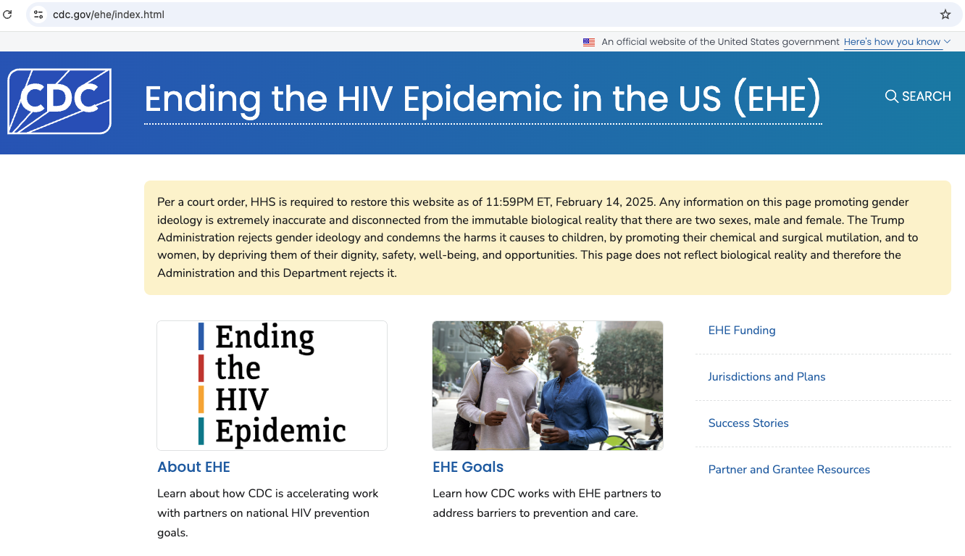
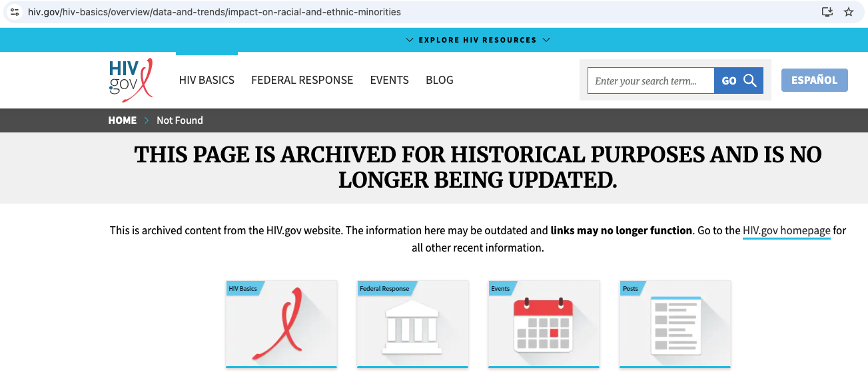
Epilogue
Figure 3. Ending the HIV Epidemic in the US website (CDC, n.d.)
Retrieved May 17, 2025
Figure 4. Impact on racial and ethnic minorities (HHS, 2025)
Retrieved May 17, 2025
Notes:
I would be remiss not to acknowledge what has occurred in the United States in the past 6 months, since finishing and submitting this paper.
The current Secretary of Health & Human Services, Robert Kennedy, Jr., routinely shares health disinformation including questioning HIV as the cause of AIDS. I have included a video clip of one example in this presentation’s references.
One of the Trump Administration’s earliest efforts was to purge federal government references to diversity, equity and inclusion. While these actions are being fought in court, there are already consequence to what and how information about HIV/AIDS is shared by the US federal government. CDC’s website about the Ending the HIV Epidemic initiative currently states:
“This page does not reflect biological reality and therefore the Administration and this Department rejects it.”
Data and trends specific to HIV’s impact on racial and ethnic minorities are no longer tracked. This is consequential considering the identified need for interventions to be socially and culturally specific.
Furthermore, in March 2025, the Trump administration dismissed the entire staff of the US Office of Infectious Diseases & HIV Policy, and other offices including the Office of Minority Health, the Policy and Data Division supporting the Ryan White HIV/AIDS Program, and hundreds of employees, including those who support the Ending the HIV Epidemic PrEP program.
The consequences of these actions are broad and put at risk much of the progress made towards de-stigmatizing HIV and supporting children and families impacted by HIV/AIDS. In 2021 alone, there were 1.65 million new cases of HIV.

Slide 12
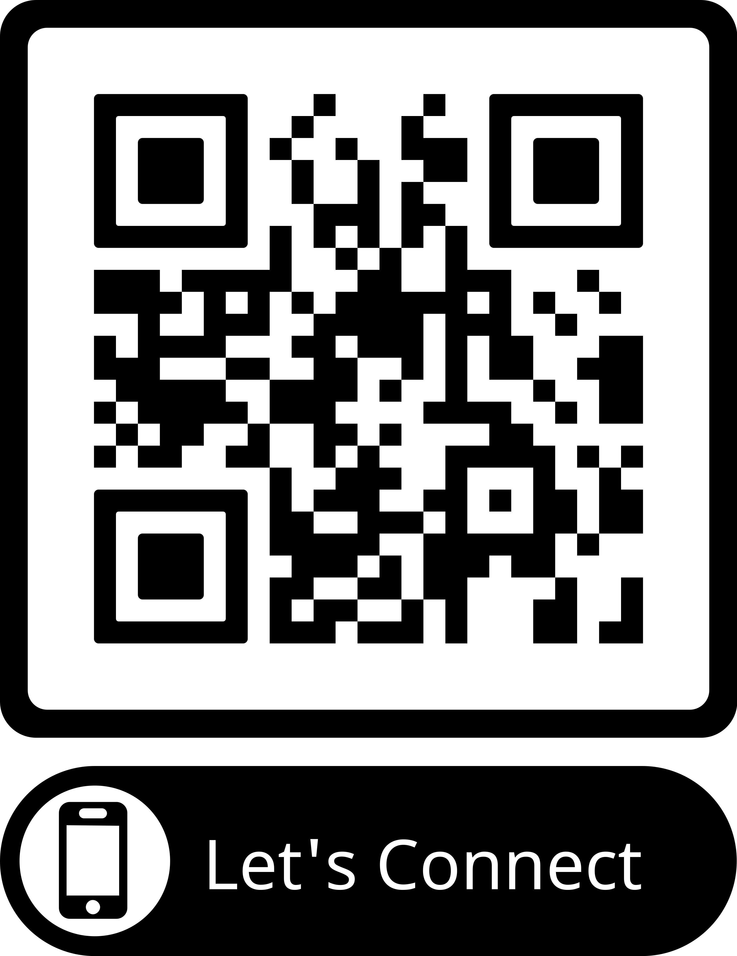
Thank you!
“…the silence in many HIV-affected families may now extend the stigma into the next generation, emotionally burdening both HIV-infected caregivers and HIV-affected children”
(Nostlinger et al., 2004, p. 647)
Notes:
In this time, I am particularly grateful to being a part of this international research community and hope to work with you together as we move forward. Thank you.

Slide 13
Presentation References*
Burke, J. (2025, March 28). HHS Staff Cuts. HIV+HEP Policy Institute. https://hivhep.org/press-releases/statement-on-elimination-of-hhs-office-of-infectious-diseases-hiv-policy-other-hhs-staff-cuts/
Cambridge Dictionary. (n.d.). Disclosure. In Cambridge Dictionary. Retrieved September 24, 2024, from https://dictionary.cambridge.org/us/dictionary/english/disclosure
Case, D. & Given, L. (2016). Looking for Information: A Survey of Research on Information Seeking, Needs, and Behavior: Vol. Fourth edition. Emerald Group Publishing Limited. https://search.ebscohost.com/login.aspx?direct=true&AuthType=shib&db=nlebk&AN=1427926&authtype=sso&custid=s8366013&site=ehost-live&scope=site&custid=s8366013
Cyrus, C., Firdawsi, O., Wang, J., Njuguna, I. N., Wamalwa, D. C., Slyker, J. A., John-Stewart, G. C., O’Malley, G., & Wagner, A. D. (2023). “When they are all grown, I will tell them”: Experience and perceptions of parental self-disclosure of HIV status to children in Nairobi, Kenya. BMC Public Health, 23(1), 519–519. https://doi.org/10.1186/s12889-023-15387-3
Da, W., Zhang, R., Zhou, Y., Shen, Z., Qiao, S., & Li, X. (2024). Impact of children’s age on parental HIV disclosure: a parental HIV disclosure intervention among parents living with HIV in China. AIDS Care, 36(sup1), 76–84. https://doi.org/10.1080/09540121.2024.2308744
MedPage Today. (2024, December 18). RFK falsely claims that poppers cause AIDS. [Video]. YouTube. https://youtu.be/7BW8DbOd9wY?si=dwiF6PHHDwA7WZhw
Nöstlinger, C., Jonckheer, T., de Belder, E., van Wijngaerden, E., Wylock, C., Pelgrom, J., & Colebunders, R. (2004). Families affected by HIV: parents’ and children’s characteristics and disclosure to the children. AIDS Care, 16(5), 641–648. https://doi.org/10.1080/09540120410001716432
Roser, M. & Ritchie, H. (2023). Children orphaned due to AIDS. Our world in data. https://ourworldindata.org/grapher/number-of-children-orphaned-from-aids
Roser, M. & Ritchie, H. (2023). HIV / AIDS. Our world in data. https://ourworldindata.org/hiv-aids
The Britannica Dictionary. (n.d.) Disclosure. In The Britannica Dictionary. Retrieved September 24, 2024, from https://www.britannica.com/dictionary/disclosure
U.S. Centers for Disease Control and Prevention. (n.d.) Ending the HIV Epidemic in the US (EHE). U.S. Centers for Disease Control and Prevention. https://www.cdc.gov/ehe/index.html
U.S. Department of Health and Human Services (HHS). (2025, March 20). Impact on racial and ethnic minorities. U.S. Department of Health and Human Services (HHS). https://www.hiv.gov/hiv-basics/overview/data-and-trends/impact-on-racial-and-ethnic-minorities
Wilson, T. D. (1999). Models in information behaviour research. Journal of Documentation, 55(3), 249–270. https://doi.org/10.1108/EUM0000000007145
*All research references can be found in paper

